Slide 1

The Road to the 2020 Census
Justine Chen
Partnership Specialist
U.S. Census Bureau
Los Angeles Regional Census Center
Notes:
Now we all live in the US and enjoy the nation’s benefits. It’s important we learn about one of the largest efforts the nation will undergo.
It has to do with all of us, no matter where you were born. We all live here now and this is our community.

Slide 2
Everyone Counts!
The census counts every person
living in the U.S., regardless of citizenship,
once, only once, and in the right place.

Slide 3
Why Do a Census?

Slide 4
It’s in the U.S. Constitution
Article 1, Section 2
“The actual Enumeration shall be made within three Years after the first Meeting of the Congress of the United States, and within every subsequent Term of ten Years, in such Manner as they shall by Law direct.”
Notes:
It’s the 6th sentence – freedom of speech didn’t even make it in there until there was an amendment!
For nearly 200 years our Constitution mandates that we count the population every 10 years! Second, it’s about representation that includes the reapportionment of 435 congressional seats. Lastly, but certainly not least, It is about federal funding, $675 billion comes back to state and local governments for vital services based on our census figures.
The American form of government democracy depends on Equal Representation in Congress and determining equal representation depends on the Census!
The Census is at the core of our democratic form of government.
Since 1790 the census has counted every resident. Our goal is to count everyone, count them once and to count them in the right place.

Slide 5
It’s about federal funding
Census data determine how
more than $1.5 trillion are spent,
supporting your state, county and community’s vital programs.
Notes:
Programs supported by federal dollars include:
School Districts
Hospitals and Public Health Programs
Social Service Programs WIC, SNAP etc.
State and Local Community Development Block Grants (CDBG) for housing and small business programs
Public Infrastructure improvement e.g. transportation highways, roads, bridges, harbors.

Slide 6
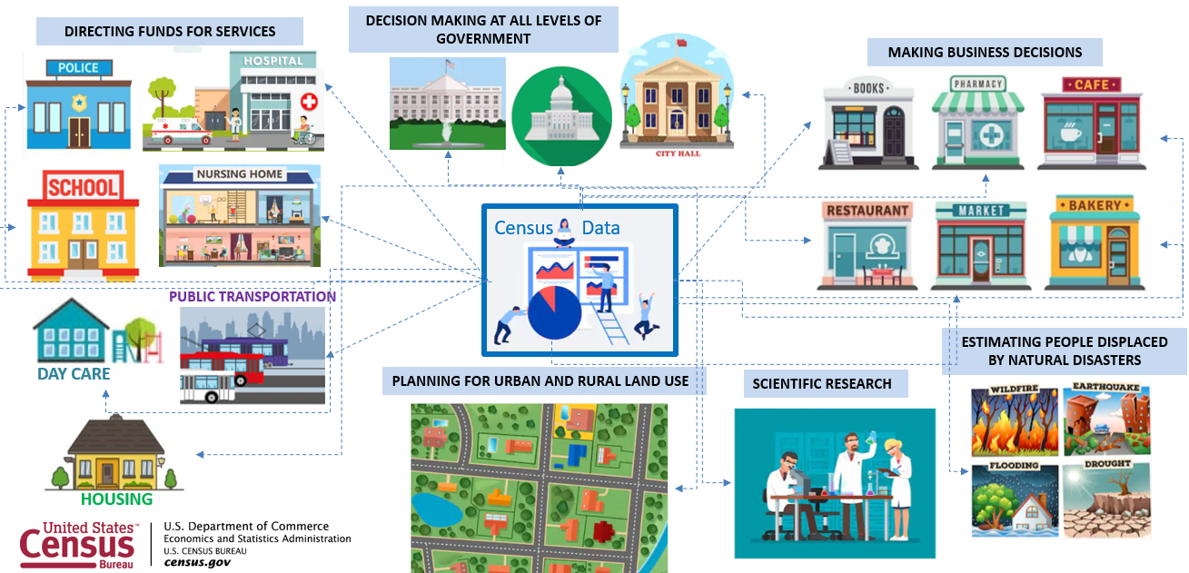
Census Data is important

Slide 7
It’s about fair representation
The results of the census are used to
reapportion the House of Representatives,
determining how many seats each state gets.

Slide 8
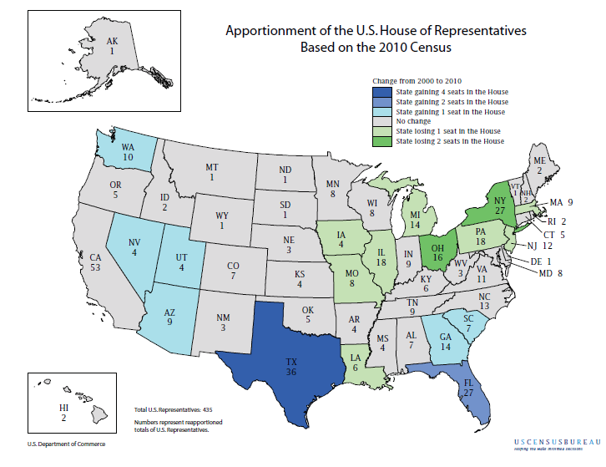
Notes:
435-seat game of musical chairs

Slide 9
It’s about redistricting
After each census, state officials use the results to redraw the boundaries of their congressional and state legislative districts, adapting to population shifts.

Slide 10
Who are the Hard-to-Count?
Young children
Highly mobile persons
Racial and ethnic minorities
Non-English speakers
  Native Hawaiian and
  Other Pacific Islanders
  American Indian and Alaska Natives
Low-income persons
Veterans
Senior Citizens
Renters
Farm/Migrant Workers
Persons experiencing homelessness
Undocumented immigrants
Persons who distrust the government
Persons with mental or physical disabilities
Persons who do not live in traditional housing

Slide 11
Why does the Census Matter?
Power
Money
More than $1.5 trillion distributed annually
State redistricting of legislative boundaries
Re-apportionment of Congressional seats
Power in representation
Over $115 billion annually to California*

Slide 12
Responses are Protected by Law U.S. Code Title 13
The Census is confidential and required by law
Results of the Census are reported in statistical format only
We do not share respondent personal information or responses with any other government agencies
All Census employees swear to a lifetime oath to protect respondent information
Penalties for wrongful disclosure
      Up to 5 years imprisonment and/or a fine of $250,000
Notes:
We will never share a respondents personal information with other government agencies
Results from the census are reported in statistical format only
Records are confidential for 72 years by law (Title 44, U.S. Code)
All Census Bureau employees swear a lifetime oath to protect respondent information.
Penalty for wrongful disclosure is up to 5 years imprisonment and/or a fine of $250,000

Slide 13
2020 will be easier than ever
In 2020, you will be able to
respond to the census ONLINE.
Notes:
One way street!
Title 13 of the U.S. Constitution states information provided to and collected by the U.S. Census Bureau is strictly confidential and is secure.
The U.S. Census Bureau has strong precautions in place to keep collected data safe from hacking and other cyber threats.
Its against the law to release your responses in any way that could identify you or your household.

Slide 14




New Ability to Self-Respond
Starting March 12-20, 2020
Internet* Phone* Paper Form In-person
*12 foreign languages supported: Spanish, Vietnamese, Korean, Chinese (Simplified), Russian, Arabic, Tagalog, Polish, French, Haitian Creole, Portuguese, Japanese
Notes:
Technology is making it easier to respond more than ever.
• For the first time, people will have multiple ways to self-respond –mail, phone, and online – and full choice to opt for the mode with
which they feel most comfortable.
Census Action Kiosks to become available – Map in Janurary. Go to census.lacounty.gov
• The Census Bureau will be encouraging individuals nationwide to respond whenever and wherever they are. This includes the ability for
folks to respond on the go or at community events
Mailing process still being finalized in end-to-end test.

Slide 15
What will the census ask?
The number of people living in your household.
First and last name
Age
Birth date
Race and ethnicity
Sex
Relationship to the person responding, for each person (count everyone who lives in the household, including non-family members)
Whether you rent or own
Telephone number

Slide 16
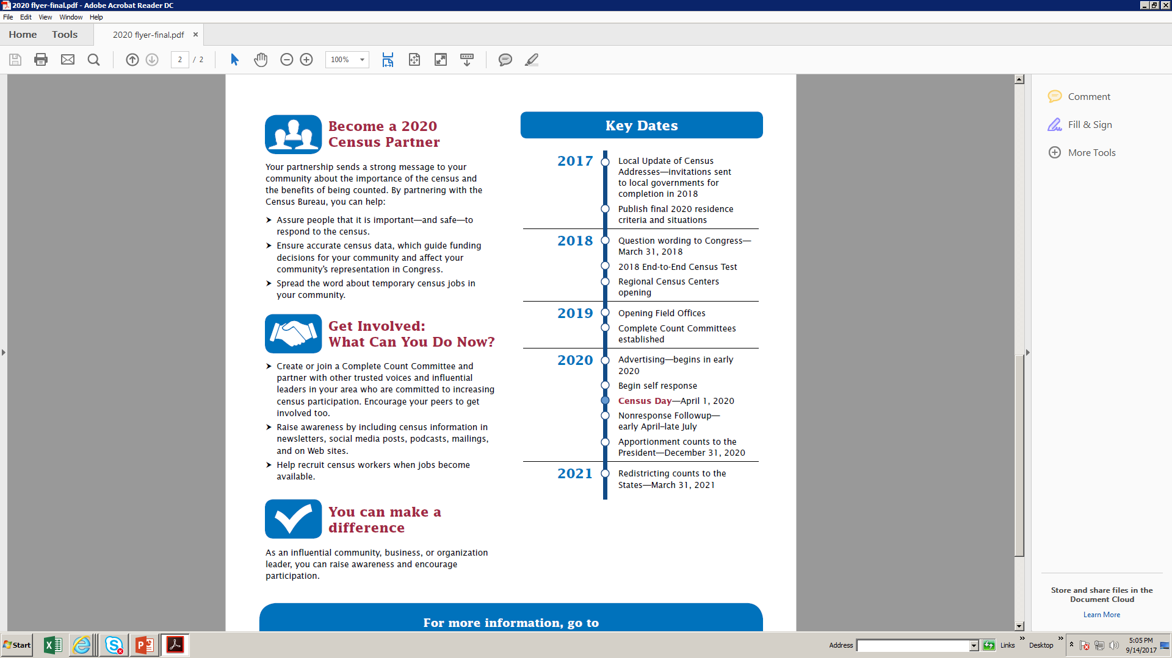
What are the next steps?
Notes:
Key dates and Milestones:
In 2017 we initiated the local update of census addresses or LUCA. LUCA is a major operation and task that allows local jurisdictions to review the Census Bureau’s Master address file for their local areas and an opportunity to update the address file with local records.
In 2017 we also published residency criteria. this is used to determine where people are counted in the 2020 Census. It is based on the concept of usual residence which simply means the place where you live and sleep most of the time.
We also count people in certain types of group facilities on census day. People who do not have a usual residence or who cannot determine their usual residence are counted where they are on census day.
In 2018 we submitted the 2020 questions wording to Congress in March as mandated.
Now that the LA Regional Census Center is open we will continue to test and prioritize the readiness of our integrated systems and how theses systems interact.
In 2019 we will be opening approximately seven Early Area Census Offices. For Los Angeles County the location will be in Van Nuys. There will be 26 total for California and 43 for the region.
Starting in 2018 we have been working with local municipalities to form complete count committees for which we are providing training. A complete count committee convenes to drive the local 2020 Census message. We are hiring for the early area Census offices which we will begin in this summer.
In 2020 we will have full blown multi-media advertising campaign. We have already contracted with team Y&R, the same advertising agency we used in the 2000 census

Slide 17
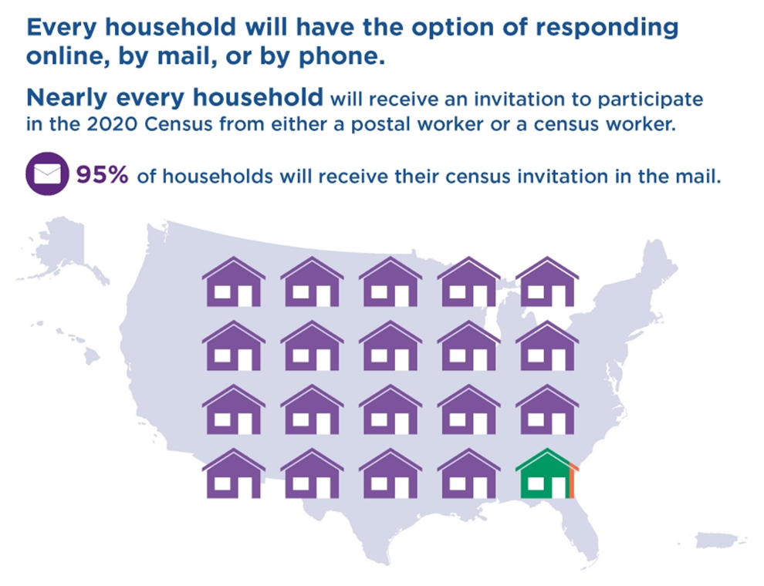
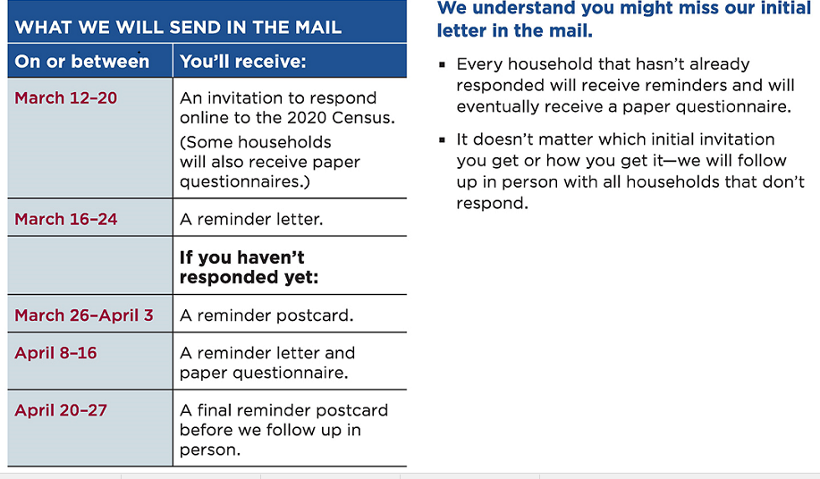
Notes:
Here is a time line of how the Census Bureau will be sending invitations and contacting the public about the census.
Internet Self Response
Starting March 23, 2020
The Census Bureau is making it easier to respond with technology.
• For the first time, people will have multiple ways to self-respond –mail，phone, online – and full choice to opt for the mode with
which they feel most comfortable.
• The Census Bureau will be encouraging individuals nationwide to respond whenever and wherever they are. This includes the ability for folks to respond on the go or at community events, even if they do not have the unique Census ID sent to their address. Ways to complete the Census Questionaire:
Mailing
By Phone
Online
In Person

Slide 18
Avoid Scams Online
The U.S. Census Bureau will not send you an email for Census 2020.
      If you receive an email, DO NOT reply, click any links, or open any attachments.
The U.S. Census Bureau will NEVER ask:
        Your social security number
        Your bank account or credit card
        Money or donations of any kind

Slide 19
2020 Census Language Program Overview
Internet
Self-Response
Census Questionnaire
Assistance
Language Guides (Video and Print)
Language Glossaries
Language Identification Card
Paper Questionnaire
& Mailing Materials
12 Non-English Languages
Respondents will be able to toggle between the languages within the instrument.
12 Non-English Languages
There is a separate phone number for each language. This information is included in the mailing materials.
59 Non-English Languages
Video and print language guides will be available online. Glossaries provide key terminology to bilingual staff. Language Identification Card expanded to 59 languages (50 in 2010). Language listed below are in order of need (top to bottom, left to right).
Spanish
Bilingual mailing materials and questionnaires will be sent to addresses in bilingual tracts.
Mailings will include instructions on responding via Internet or phone in 12 non-English languages.
Spanish
Chinese
Vietnamese
Korean
Russian
Arabic
Tagalog
Polish
French
Haitian Creole
Portuguese
Japanese
Spanish
Chinese (Mandarin and Cantonese)
Vietnamese
Korean
Russian
Arabic
Tagalog
Polish
French
Haitian Creole
Portuguese
Japanese
Spanish | Italian | Khmer | Tamil | Croatian
Chinese | Farsi | Nepali | Navajo | Bulgarian
Vietnamese | German | Urdu | Hungarian | Twi
Korean | Armenian | Romanian | Hebrew | Lithuanian
Russian | Hindi | Telugu | Malayalam | Yoruba
Arabic | Ukrainian | Burmese | Swahili | Czech
Tagalog | Bengali | Punjabi | Yiddish | Igbo
Polish | Greek | Lao | Indonesian | Marathi
French | Amharic | Hmong | Serbian | Sinhala
Haitian Creole | Somali | Albanian | Tigrinya | Slovak
Portuguese | Thai | Turkish | Ilocano | American Sign Language
Japanese | Gujarati | Bosnian | Dutch
During Nonresponse Followup enumerators use:
A bilingual handheld instrument (English/Spanish)
Bilingual materials (English/Spanish)
Instructions to respond online or by phone in 12 non-English languages
Language Identification Card
Notes:
2016 ACS 5-Year Estimates
Limited-English-Speaking Household Language Data

Slide 20
Methodology
ACS Language Data
Limited-English-Speaking Household
Validated Language List
2020 Census Language List
ACS Language Data
(2016 5-year estimates)
Languages spoken
for all households
Limited-English-Speaking Household Language Data
Languages spoken among households where there is
no one 14 years or older who speaks English only or speaks English “very well”
Cutoff at 2,000+ and 60,000+ limited-English-speaking households
Validate Languages
Verified with regional
and state level data
Assessed translation feasibility
Added American Sign Language

Slide 21
Supported Non-English Languages
(order: top to bottom, left to right)
Spanish | Italian | Khmer | Tamil | Croatian
Chinese | Farsi | Nepali | Navajo | Bulgarian
Vietnamese | German | Urdu | Hungarian | Twi
Korean | Armenian | Romanian | Hebrew | Lithuanian
Russian | Hindi | Telugu | Malayalam | Yoruba
Arabic | Ukrainian | Burmese | Swahili | Czech
Tagalog | Bengali | Punjabi | Yiddish | Igbo
Polish | Greek | Lao | Indonesian | Marathi
French | Amharic | Hmong | Serbian | Sinhala
Haitian Creole | Somali | Albanian | Tigrinya | Slovak
Portuguese | Thai | Turkish | Ilocano | American Sign Language
Japanese | Gujarati | Bosnian | Dutch
Note: Languages in bold are among the 12 non-English languages that will be supported through ISR and CQA.

Slide 22
Largest Language Needs for Census Regions
Based on languages spoken by 1,000 or more limited-English-speaking households (2016 ACS 5-year estimates)
 | Atlanta | Chicago | Denver | Los Angeles* | New York | Philadelphia
1 | Spanish | Spanish | Spanish | Spanish | Spanish | Spanish
2 | Haitian Creole | Chinese | Vietnamese | Chinese | Chinese | Chinese
3 | Chinese | Polish | Chinese | Korean | Russian | Korean
4 | Vietnamese | Arabic | Korean | Vietnamese | Portuguese | Vietnamese
5 | French | Russian | Arabic | Tagalog | Korean | Russian
6 | Korean | Korean | Navajo | Russian | Italian | Arabic
7 | Portuguese | Vietnamese | French | Japanese | Haitian Creole | French
8 | Russian | Somali | Russian | Armenian | Polish | German
9 | Arabic | German | German | Farsi | French | Italian
10 | German | French | Farsi | Arabic | Arabic | Japanese
11 | Italian | Hmong | Tagalog | Khmer | Vietnamese | Amharic
12 | Japanese | Japanese | Hindi | Punjabi | Bengali
* All listed languages will have video and print language guides. In addition, languages in
bold are among the 12 non-English languages that will be supported through ISR and CQA.

Slide 23
Largest Language Needs for LA Region
Based on languages spoken by 1,000 or more limited-English-speaking households (2016 ACS 5-year estimates)
 | Alaska | California | Hawaii | Idaho | Nevada | Oregon | Washington
1 | Spanish | Spanish | Japanese | Spanish | Spanish | Spanish | Spanish
2 |  | Chinese | Chinese |  | Chinese | Vietnamese | Chinese
3 |  | Korean | Tagalog |  | Tagalog | Chinese | Vietnamese
4 |  | Vietnamese | Korean |  | Korean | Russian | Korean
5 |  | Tagalog | Ilocano |  | Amharic | Korean | Russian
6 |  | Armenian | Vietnamese |  |  |  | Ukrainian
7 |  | Russian | Spanish |  |  |  | Japanese
8 |  | Japanese |  |  |  |  | Tagalog
9 |  | Farsi |  |  |  |  | Amharic
10 |  | Arabic |  |  |  |  | Arabic
11 |  | Punjabi |  |  |  |  | Somali
12 |  | Portuguese |  |  |  |  | Khmer
All the listed languages will have video and print language guides. In addition, languages
in bold will be among the 12 non-English languages being supported through ISR and CQA.

Slide 24
Largest Language Needs for California
(Continued from previous slide)
Based on languages spoken by 1,000 or more limited-English-speaking households (2016 ACS 5-year estimates)
1 | Spanish | 14 | Thai | 27 | Hebrew
2 | Chinese | 15 | French | 28 | Bengali
3 | Korean | 16 | Hindi | 29 | Polish
4 | Vietnamese | 17 | Hmong | 30 | Tamil
5 | Tagalog | 18 | German | 31 | Urdu
6 | Armenian | 19 | Italian | 32 | Gujarati
7 | Russian | 20 | Lao | 33 | Hungarian
8 | Japanese | 21 | Ukrainian | 34 | Greek
9 | Farsi | 22 | Romanian | 35 | Ilocano
10 | Arabic | 23 | Telugu | 36 | Turkish
11 | Punjabi | 24 | Amharic | 37 | Tigrinya
12 | Portuguese | 25 | Indonesian
13 | Khmer | 26 | Burmese
All the listed languages will have video and print language guides. In addition, languages
in bold will be among the 12 non-English languages being supported through ISR and CQA.

Slide 25
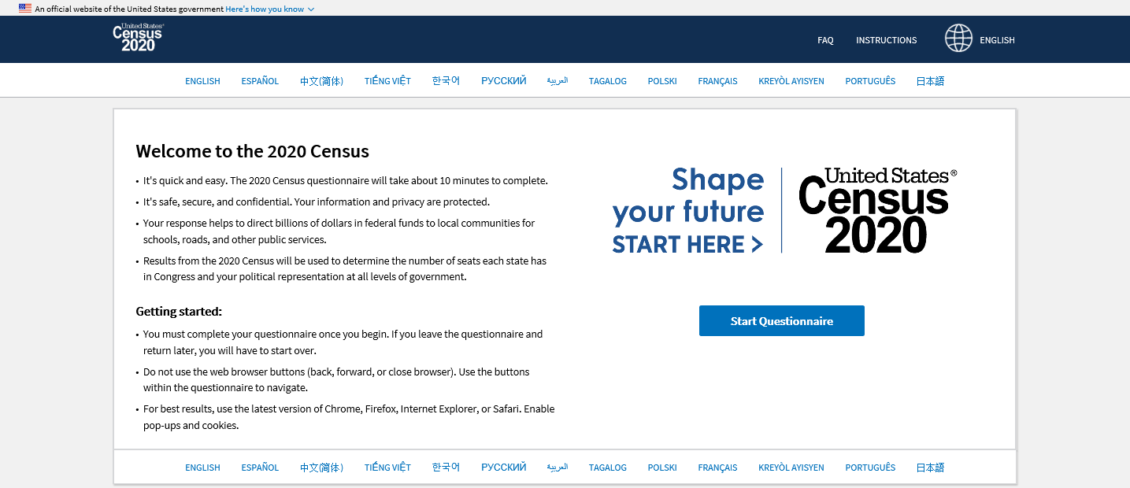
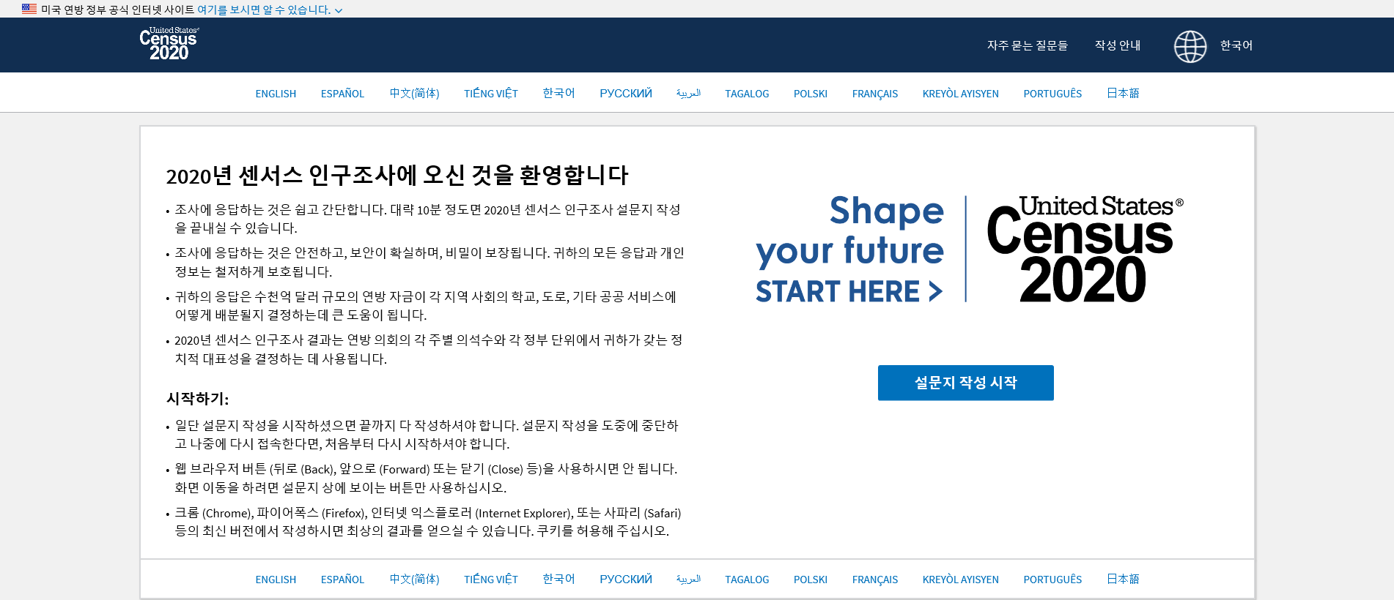
Internet Self-Response
The internet questionnaire will allow respondents to toggle between English and 12 non-English languages using a dropdown language menu at the top of each screen, and individual links at the top and bottom of each screen.

Slide 26
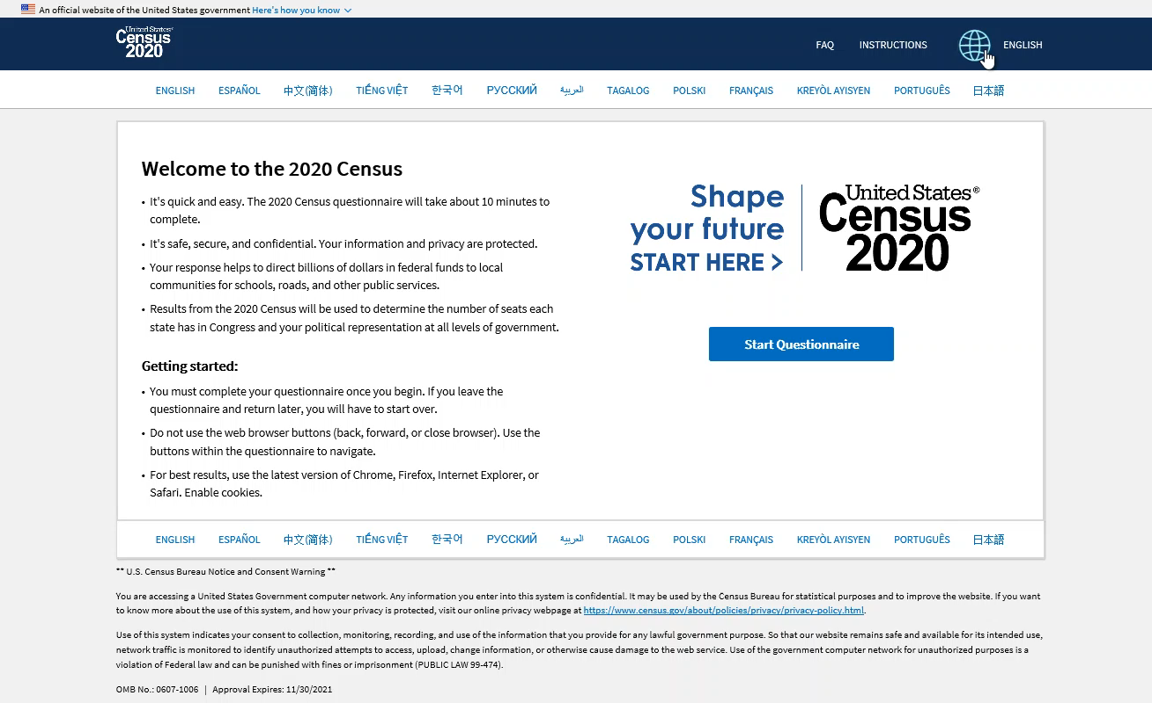
Internet Self-Response (cont’d)

Slide 27
Census Questionnaire Assistance
Census Questionnaire Assistance will allow respondents to provide their responses in English and 12 non-English languages.
Each supported language will have a dedicated phone number.
Respondents will also be able to ask questions about the 2020 Census and receive assistance in the supported languages.
Language Assistance Sheet
All mailing packages include a language assistance sheet with instructions in the 12 non-English languages.
The instructions explain how to select languages online, and provide dedicated phone numbers for each non-English language.

Slide 28
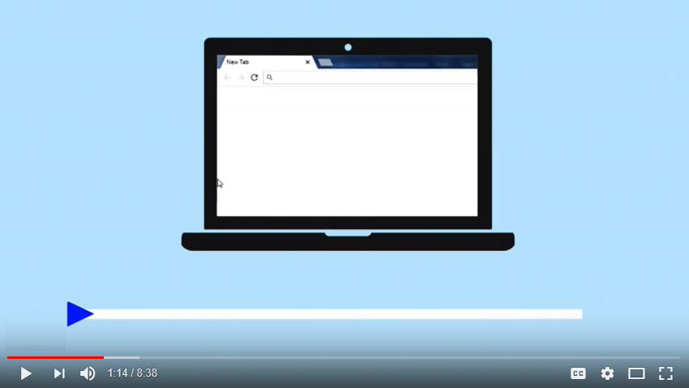
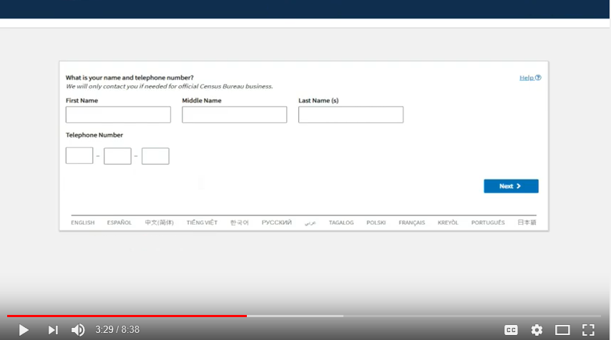
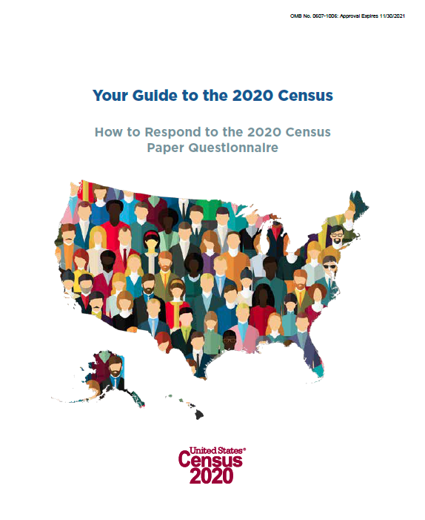
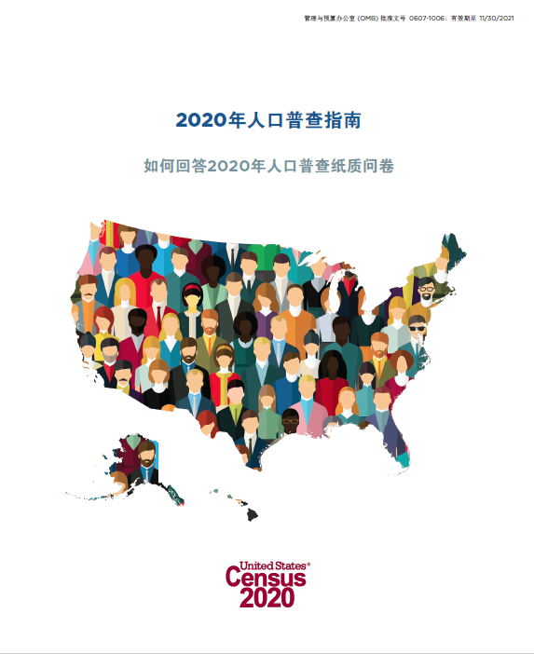
Video Language Guide
Video language guides, narrated in 59 non-English languages, will will be available online to stream or download.
Each video is about 8 minutes, and includes basic information about the 2020 Census.
Print Language Guide
Print language guides, in 59 non-English languages, will be available online, in large print and in braille.
Each guide is 8 pages, and includes basic information about the 2020 Census and translation of the questions and response categories.
.

Slide 29
Nonresponse
Followup
Enumeration Instrument (English/Spanish)
Language Identification Card
(59 non-English languages)
Language Glossaries
(59 non-English languages)

Slide 30
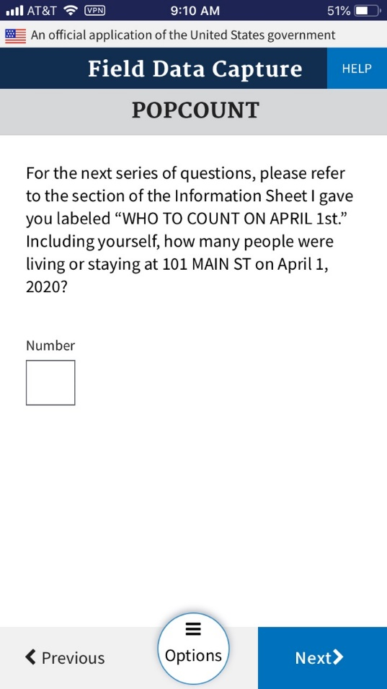
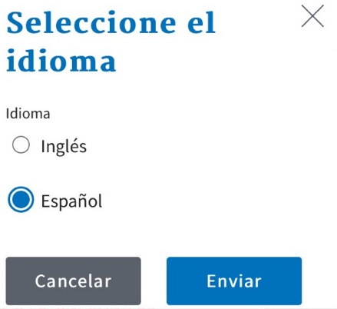
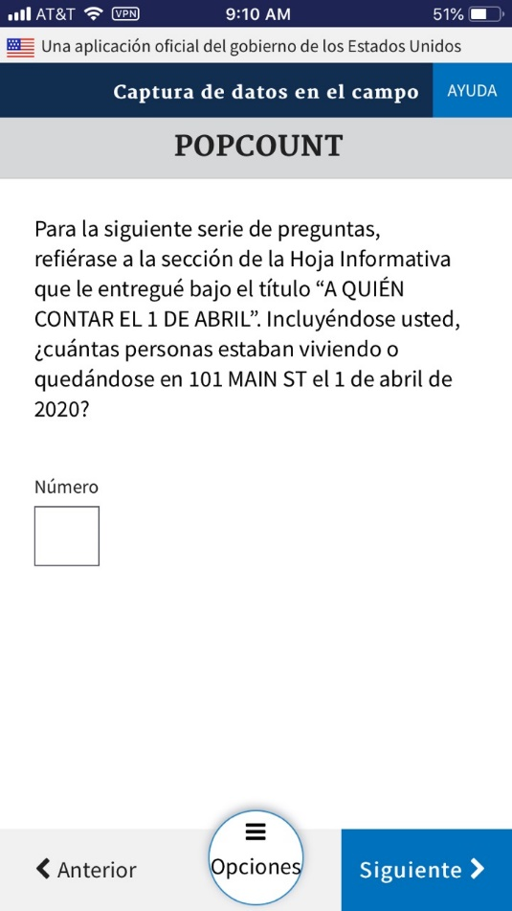
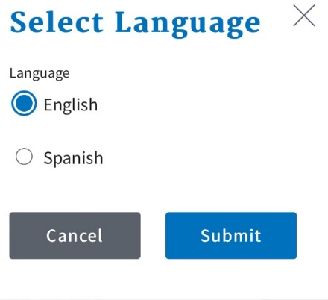
ENUM Instrument (During NRFU)
Enumerators will have the ENUM instrument available in English and Spanish, and will be able to toggle between the two languages, as needed.

Slide 31
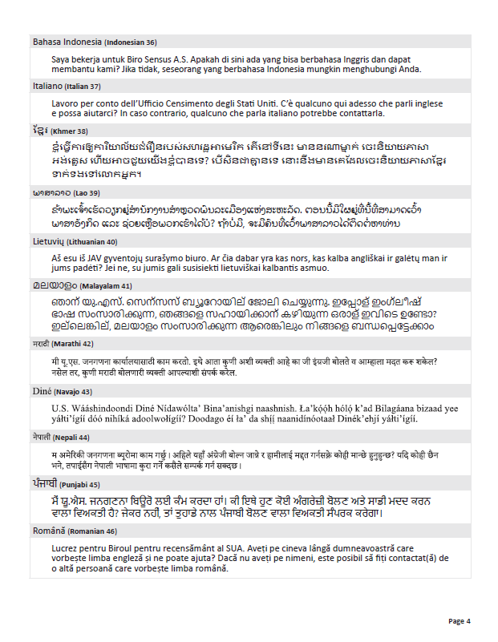
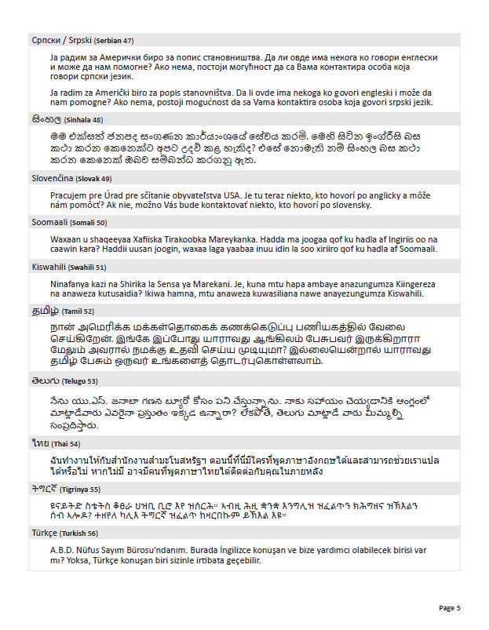
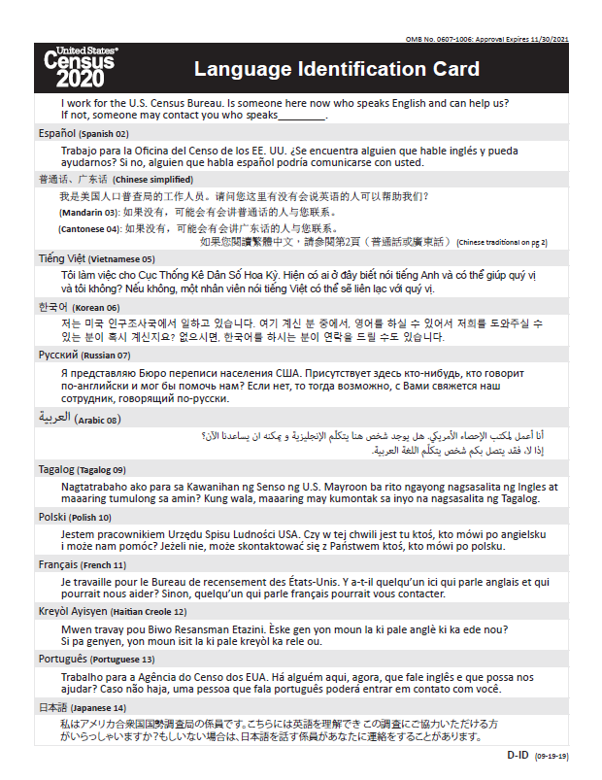
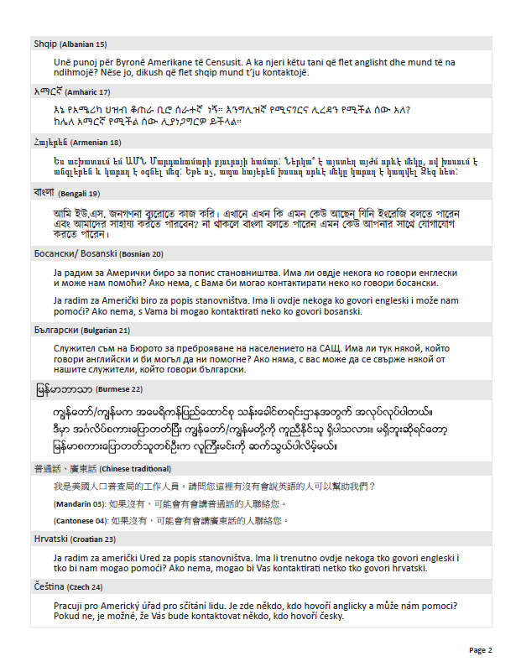
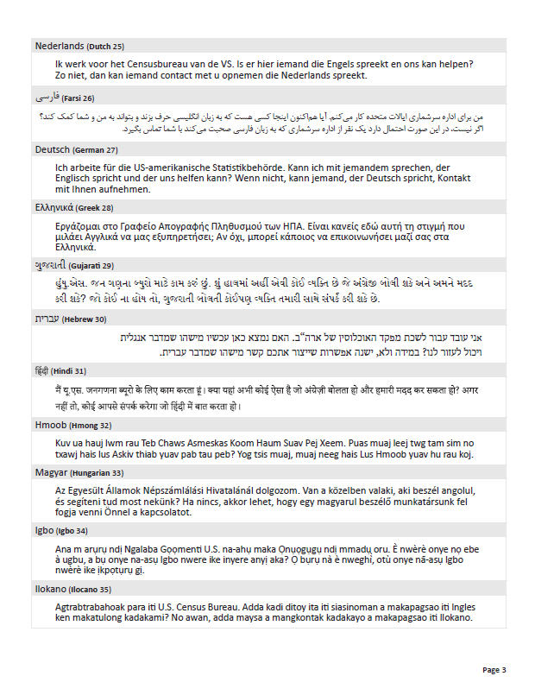
Language Identification Card
I work for the U.S. Census Bureau. Is someone here now who speaks English and can help us? If not, someone may contact you who speaks _________.
When an enumerator encounters a language barrier at the door, they will be able to show the Language Identification Card which features a brief statement in 59 non-English languages.
Enumerators use the Language Identification Card to help identify the language spoken by a household.

Slide 32
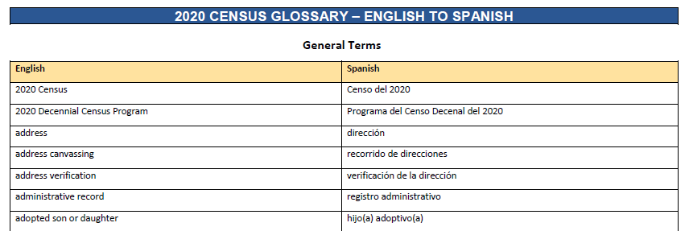
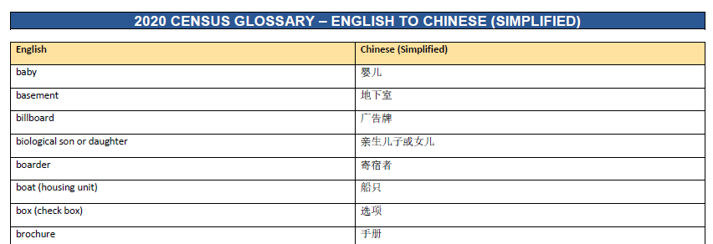
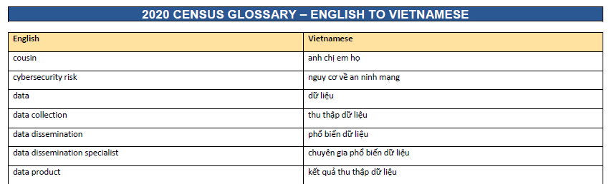
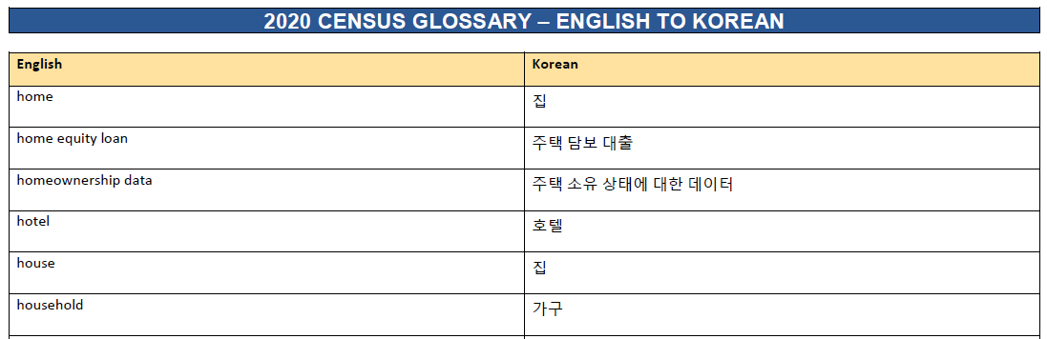
Language Glossaries
The Census Bureau will provide the Language Identification Card to field staff that help identify a language spoken by a household.
When an enumerator encounters a language barrier at the door, they will be able to show the Language Identification Card that features a brief statement in 59 non-English languages.
https://www.census.gov/programs-surveys/decennial-census/2020-census/planning-management/language-resources/language-glossaries.html

Slide 33
Avoid Scams at Home
If someone visits your home, verify their identity by checking that they have:
    Valid photo ID badge, a Department of Commerce watermark, and an expiration date.
    Census Bureau phone/laptop and a bag with the Census Bureau logo.
If you want to verify that someone is a legitimate Census Bureau employee, you can look up their name at:
      https://www.census.gov/cgi-bin/main/email.cgi
      If you have more questions or need to report a scam,
      call the U.S. Census Bureau at (818) 267-1700 or (800) 992-3530.

Slide 34
Publicly Available
Resources
Language Support Memo
Language Resources Webpage

Slide 35
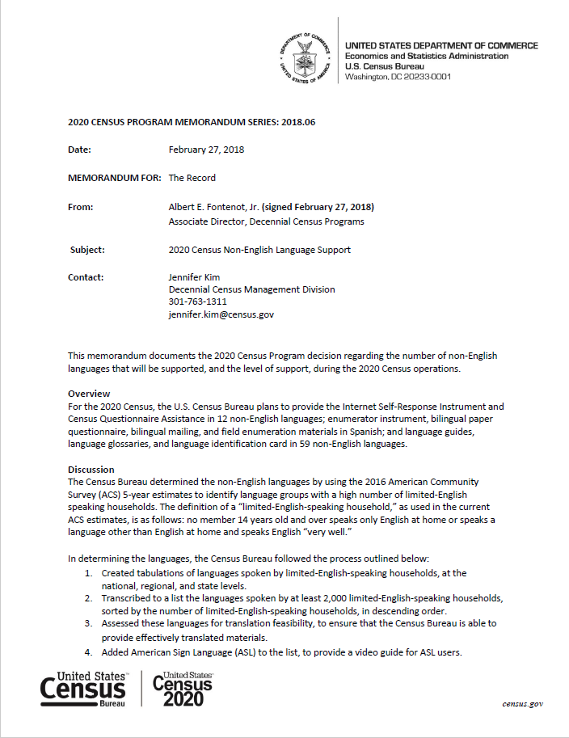
2020 Census Non-English Language Support Memo
This memorandum documents the 2020 Census Program decision regarding the number of non-English languages that will be supported, and the level of support, during the 2020 Census operations.
https://www.census.gov/programs-surveys/decennial-census/2020-census/planning-management/memo-series/2020-memo-2018_06.html

Slide 36
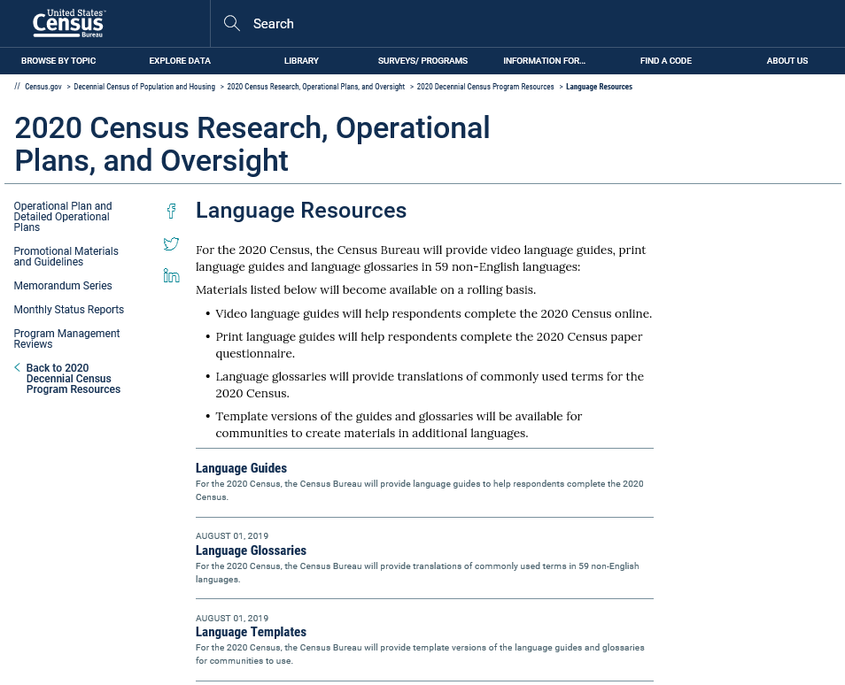
Language Resources Webpage
The census.gov website will include video language guides, print language guides, language glossaries, and template versions of the guides and glossaries.
https://www.census.gov/programs-surveys/decennial-census/2020-census/planning-management/language-resources.html

Slide 37
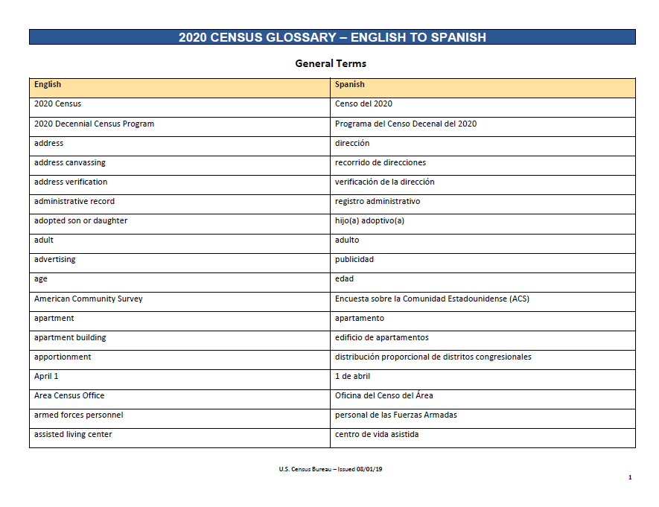
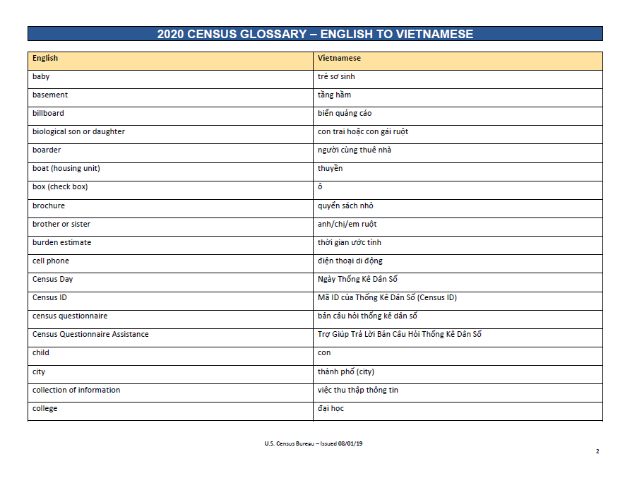
Language Resources Webpage (cont’d)
Print language guides, language glossaries, and templates are available now at
https://www.census.gov/programs-surveys/decennial-census/2020-census/planning-management/language-resources.html
Video language guides in 59 non-English languages will become available in early 2020
59 Non-English Languages
Spanish | Italian | Khmer | Tamil | Croatian
Chinese | Farsi | Nepali | Navajo | Bulgarian
Vietnamese | German | Urdu | Hungarian | Twi
Korean | Armenian | Romanian | Hebrew | Lithuanian
Russian | Hindi | Telugu | Malayalam | Yoruba
Arabic | Ukrainian | Burmese | Swahili | Czech
Tagalog | Bengali | Punjabi | Yiddish | Igbo
Polish | Greek | Lao | Indonesian | Marathi
French | Amharic | Hmong | Serbian | Sinhala
Haitian Creole | Somali | Albanian | Tigrinya | Slovak
Portuguese | Thai | Turkish | Ilocano | American Sign Language
Japanese | Gujarati | Bosnian | Dutch

Slide 38
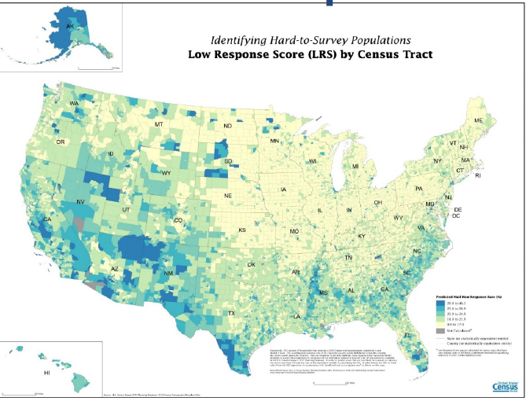
Response Area Outreach Map
www.census.gov/roam
Notes:
You can look up your neighborhood at census.gov/roam
Communities with historically low response rates:
Children under 5
Senior Citizens
People with Disabilities
Renters
Foreign Born/Immigrant population
Farm Workers
Refugees
Homeless

Slide 39
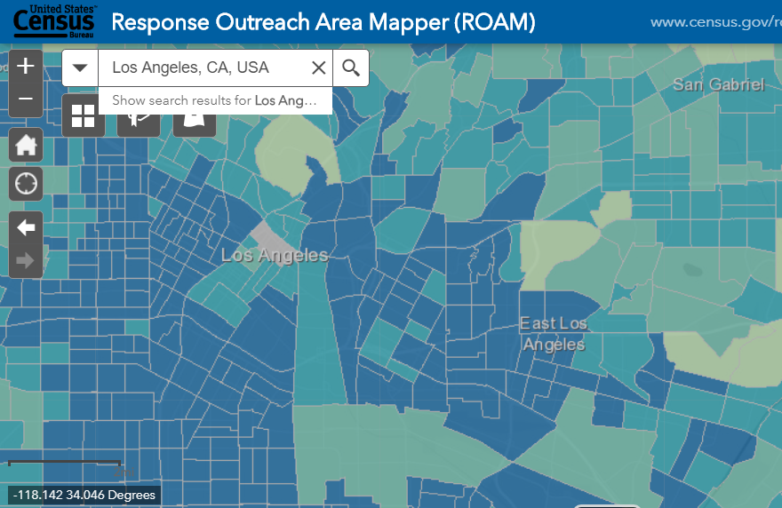
Where We Are: Los Angeles

Slide 40
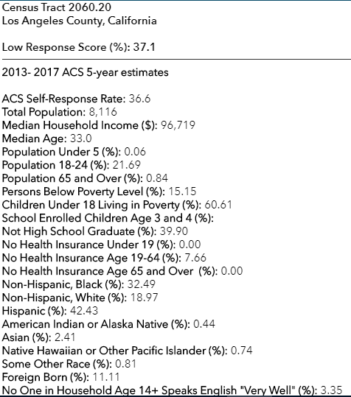
Los Angeles Census Tract 2060.20
Notes:
Census Tract 4331.01
Los Angeles County, California
Low Response Score (%): 26.4
2013- 2017 ACS 5-year estimates
ACS Self-Response Rate: 53.0
Total Population: 2,314
Median Household Income ($): 40,855
Median Age: 43.3
Population Under 5 (%): 5.19
Population 18-24 (%): 6.78
Population 65 and Over (%): 18.19
Persons Below Poverty Level (%): 17.50
Children Under 18 Living in Poverty (%): 35.60
School Enrolled Children Age 3 and 4 (%):
Not High School Graduate (%): 45.01
No Health Insurance Under 19 (%): 2.02
No Health Insurance Age 19-64 (%): 25.16
No Health Insurance Age 65 and Over (%): 0.00
Non-Hispanic, Black (%): 0.13
Non-Hispanic, White (%): 2.77
Hispanic (%): 46.54
American Indian or Alaska Native (%): 0.17
Asian (%): 49.91
Native Hawaiian or Other Pacific Islander (%): 0.00
Some Other Race (%): 0.00
Foreign Born (%): 54.36
No One in Household Age 14+ Speaks English "Very Well" (%): 42.00
Population 5+ Who Speak English Less Than "Very Well" and Speak Spanish (%): 14.54
Population 5+ Who Speak English Less Than "Very Well" and Speak Russian (%): 0.00
Population 5+ Who Speak English Less Than "Very Well" and Speak Chinese (%): 29.81
Population 5+ Who Speak English Less Than "Very Well" and Speak Korean (%): 0.00
Population 5+ Who Speak English Less Than "Very Well" and Speak Vietnamese (%): 6.43
Population 5+ Who Speak English Less Than "Very Well" and Speak Tagalog (%): 0.00
Population 5+ Who Speak English Less Than "Very Well" and Speak Arabic (%): 0.00
Total Housing Units: 686
Total Occupied Housing Units: 650
Renter Occupied Housing Units (%): 39.08
Married Couple Households with Child Under 18 (%): 31.17
Family Occupied Housing Units with Related Children Under 6 (%): 17.37
Population 1+ Who Moved From Another Residence Within the Last Year (%): 3.47
Vacant Housing Units (%): 5.25
Multi-Unit (10+) Housing (%): 13.99
Households with No Computing Device (%): 18.15
Households with Computer (%): 67.54
Households with Only Smartphone (%): 6.00
Households with No Internet Access (%): 22.62
Households with Broadband Internet Access (%): 59.85
Population with No Computing Device (%): 9.83
Population with Broadband Internet and Computing Device (%): 83.57

Slide 41

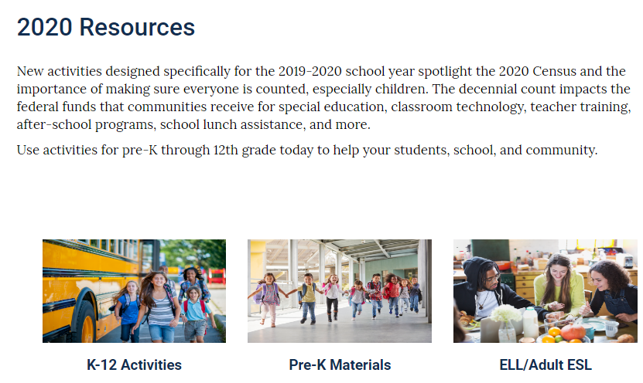
census.gov/schools
Notes:
You can look up your neighborhood at census.gov/roam
Communities with historically low response rates:
Children under 5
Senior Citizens
People with Disabilities
Renters
Foreign Born/Immigrant population
Farm Workers
Refugees
Homeless

Slide 42

Recruiting
2020census.gov/jobs
1-855-JOB-2020
(Recruiting Hotline)

Slide 43
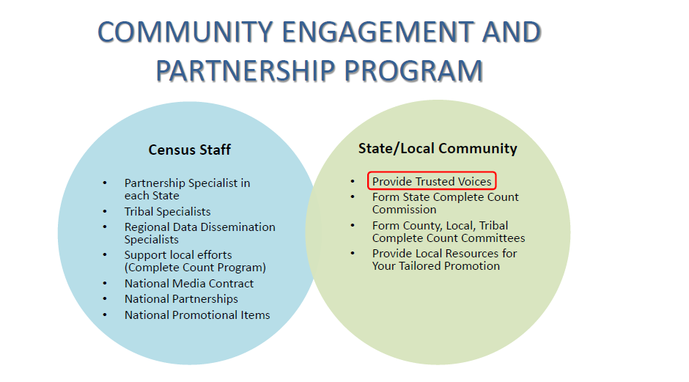
2020 Census Phases
  Education Phase- 2018-2019
  Awareness Phase- April 2019
  Motivation Phase - March – May 2020
  Reminder Phase- May – July 2020
  Thank You Phase- Starts July 2020

Slide 44

Complete Count Committees
Bring structured, focused unified outreach and communication campaign to their communities.
Tribal, state, and local governments work together with partners in their communities to form CCCs to promote the 2020 Census to their constituents. Community-based organizations also establish CCCs that reach out to their constituents.
  Committee members are experts in the following areas:
    Government
    Media
    Workforce development
    Business
    Education
    Community Organizations
    Faith-Based Community
    Other, Based on needs
Notes:
Our intention and Goal is a complete and accurate census!
-the success of the census depends on EVERYONE’s participation and you can help by forming a Complete Count Committee!
-What is a CCC? The work of a complete count committee is in providing the structure, the focus, and the unification of efforts. It can be convened by a State, County, City/town and/or community group.
State CCCs
-As you Know the State of California has formed a State Complete Count Commission.
This structure bridges-collaboration efforts with your local and state agencies who serve historically hard to count populations: Veterans, People with Disabilities, Homeless, Immigrants, Seniors, Non-English Speakers, Children under 5.
-Complete Count Committees develop an outreach plan to encourage residents to respond to the Census and explain the benefits of being counted: Especially how the census figures are critical for each municipality to receive their fair share of funding. CCC’s know the value of one trusted voice telling another person that the Census is east to fill out, safe, and important.
CCC Activities
-The composition of your CCC is dependent on the unique challenges and strengths of your community.
Your tailored plan will determine the details of how and what the Committee will take on: -
host small and large events, display promotional items at your place of work, on your website and encourage businesses to post posters on their store fronts.

Slide 45
Counting on You
for the 2020 Census
Encourage
Organize
Invite
Apply
2020census.gov/jobs
855-JOB-2020
Notes:
We need your help to reach more people in the community, especially the hard to count.
We need your connections to more organizations
We need your support and partnership to help us Engage, Encourage, and Educate!

Slide 46
10 minutes of your time will impact your community for the next 10 years.

Slide 47

Easy, Safe, Important!

Slide 48

Contact Information
Justine Chen
Partnership Specialist
Justine.F.Chen@2020census.gov
(818) 963-6992
Los Angeles Regional Census Center
555 W. 5th St, 30th Floor
Los Angeles, CA 90013
@uscensusbureau

Slide 49
Your data is confidential
Federal law protects your census responses. Your answers can only be used to produce statistics. By law we cannot share your information with immigration enforcement agencies, law enforcement agencies, or allow it to be used to determine your eligibility for government benefits.
Notes:
One way street!
Title 13 of the U.S. Constitution states information provided to and collected by the U.S. Census Bureau is strictly confidential and is secure.
The U.S. Census Bureau has strong precautions in place to keep collected data safe from hacking and other cyber threats.
Its against the law to release your responses in any way that could identify you or your household.
We take a life-long oath to not give out any data

